Slide 1
Testing numerical codes for simulating 3D thermal convection in faulted geothermal systems
Fabien Magri (1,2) , Norihiro Watanabe (1) , Olaf Kolitz(1) ,
Wenqing Wang(1) , Mauro Cacace (3)
(1) UFZ – Helmholtz Centre for Environmental Research
(2) Free University Berlin, Dep. Of Hydrology
(3) GFZ – German Centre for Geosciences, Potsdam Germany
Geomod 2016 conference
Montpellier, France | 17-20 October 2016

Slide 2
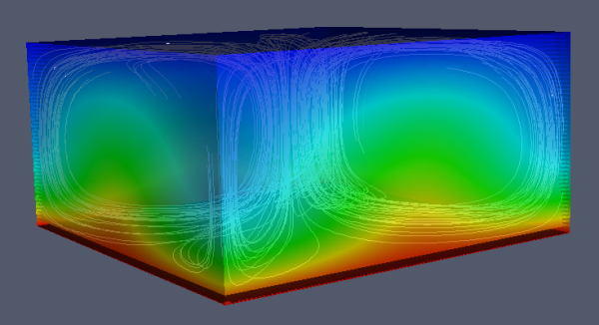
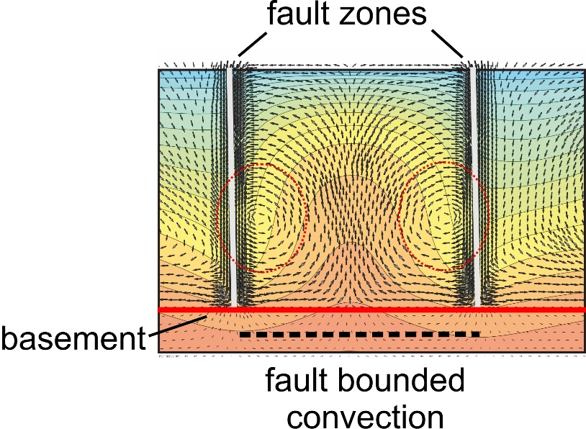
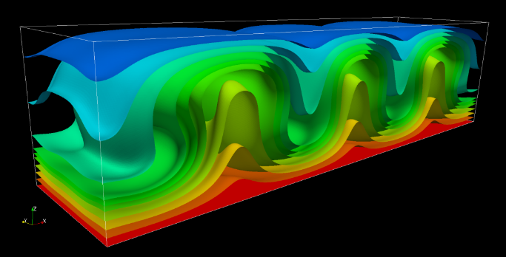
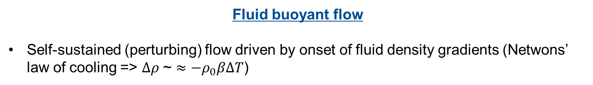
Introduction
Fluid buoyant flow
Self-sustained (perturbing) flow driven by onset of fluid density gradients (Netwons’ law of cooling => $∆ρ$ ~ $≈−ρ_{0}β∆T$)
3D streamlines (vorticity equation) and thermal anomalies

Slide 3
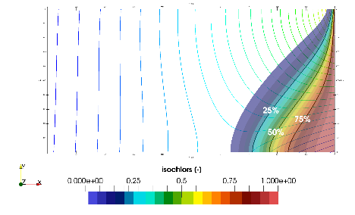
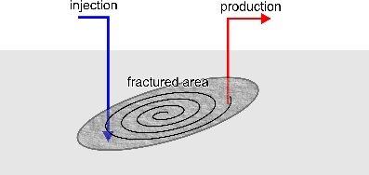
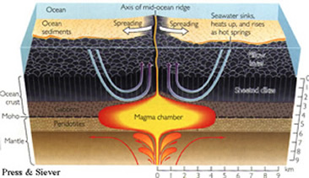
Introduction
Fluid buoyant flow
Recognized to play an important role in numerous natural an engineered applications
Application | Case | Pattern
Saltwater | Intrusion
 | Upconing
 | Stratification/flushing
Geothermics | Heat extraction
 | HDR & high-enthalpy systems
Others | Radionuclides released from a repository
 | Ore deposits
 | Diagenetic processes in sedimentary basins
 | Magma dynamics

Slide 4
Mathematical modelling of onset conditions and evolution
A large variety of numerical models have been developed.
“Pollutant” or “Energy” tracer models simulate the transport accurately.
High fluid density and viscosity changes: hydrodynamic properties estimation and velocity fields (pressure differentiation) not accurate.

Slide 5
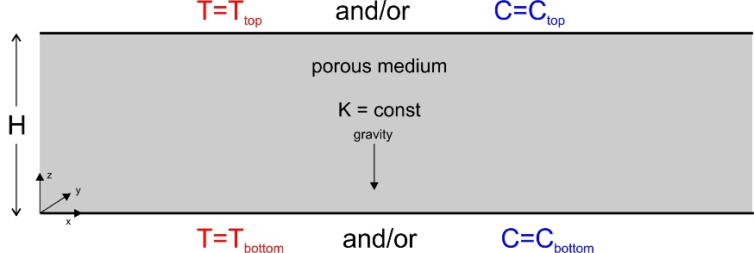
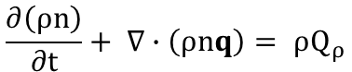
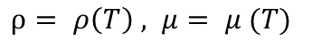
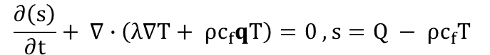
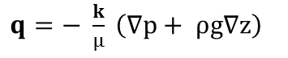
Horton-Rogers-Lapwood problem: a classical
Problem formulation
Fluid mass conservation
$$\frac{∂\left(ρn\right)}{∂t}+ ∇∙\left(ρnq\right)= ρQ_{ρ}$$
Momentum (linearized)
$q=− \frac{k}{μ} \left(∇p+ ρg∇z\right)$
$$\frac{∂\left(s\right)}{∂t}+ ∇∙\left(λ∇T+ ρc_{f}qT\right)=0 , s=Q − ρc_{f}T$$
Energy (flux divergence)
Equations Of State (EOS)
$ρ= ρ\left(T\right) , μ= μ (T)$
IAPWS releases

Slide 6
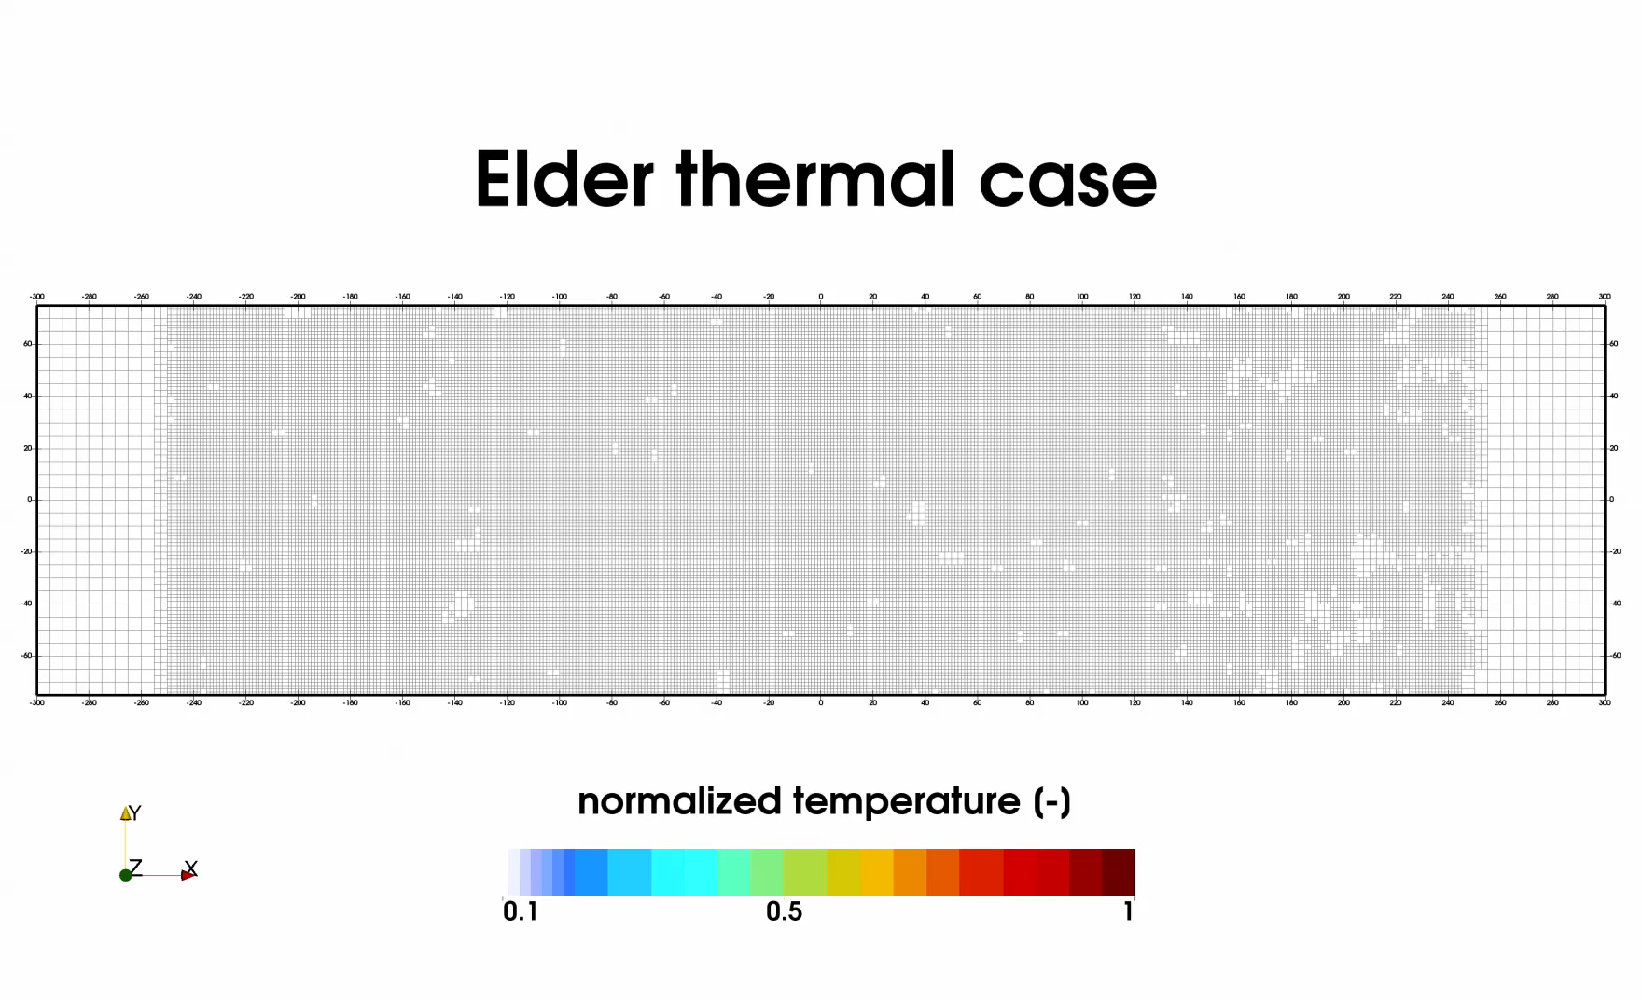
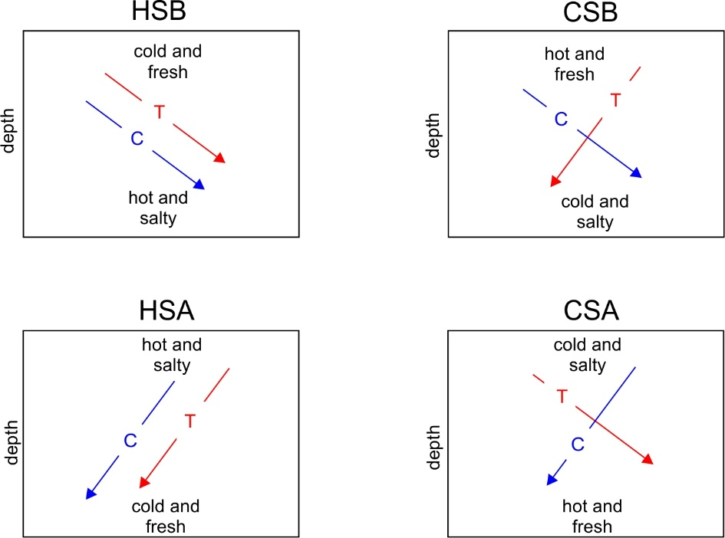
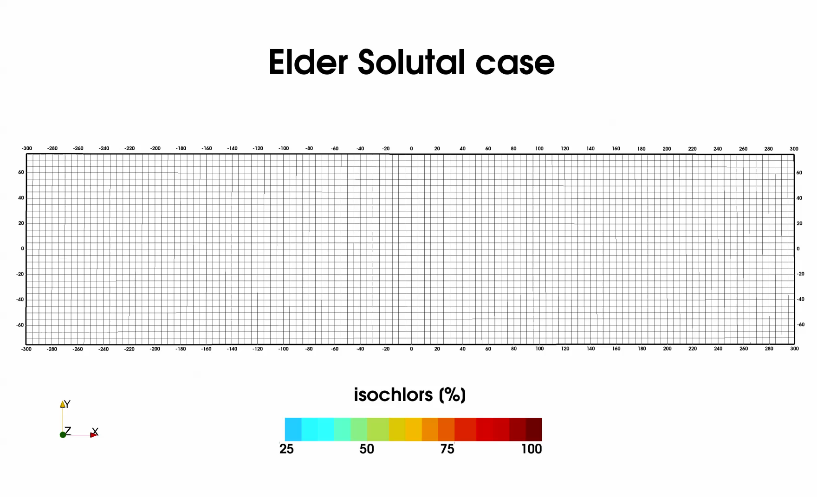
Horton-Rogers-Lapwood problem: a classical
Dynamic Regimes - schematization
Golem-MOOSE (Cacace and Jacquey)
Thermal
After Diersch (2014)
Solutal

Slide 7
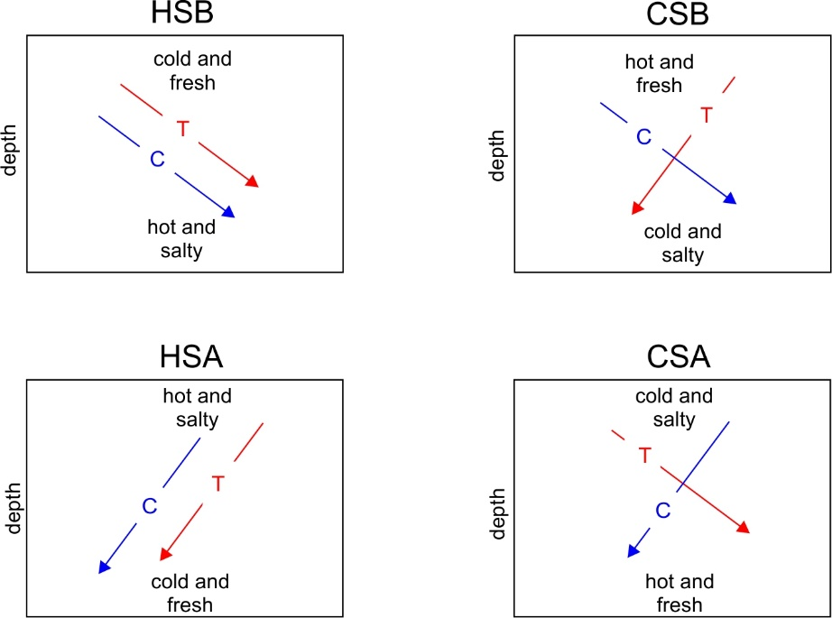
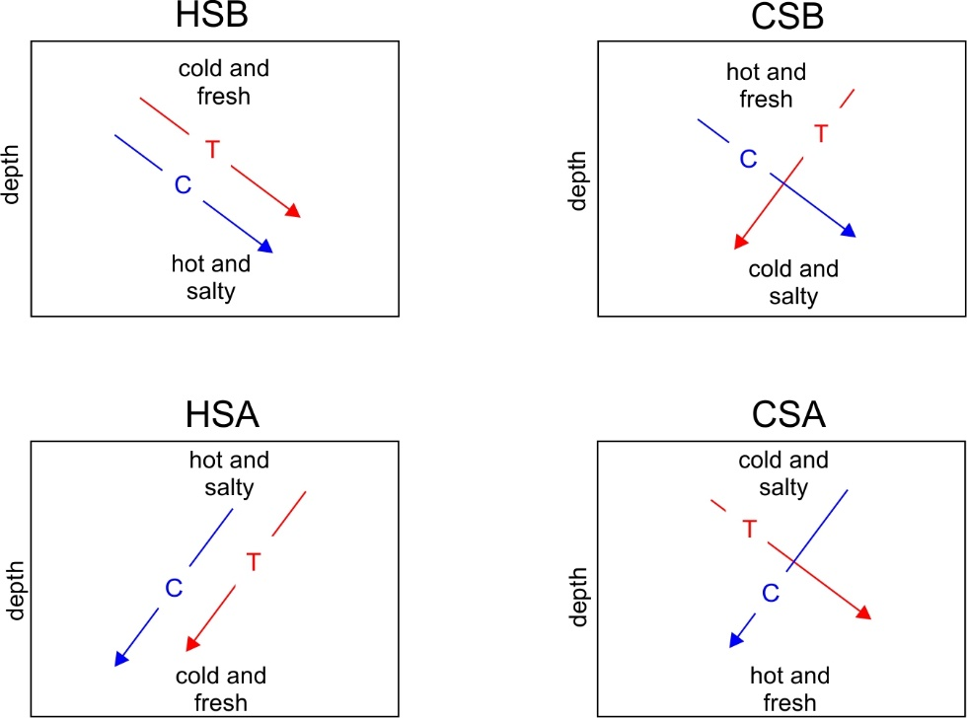
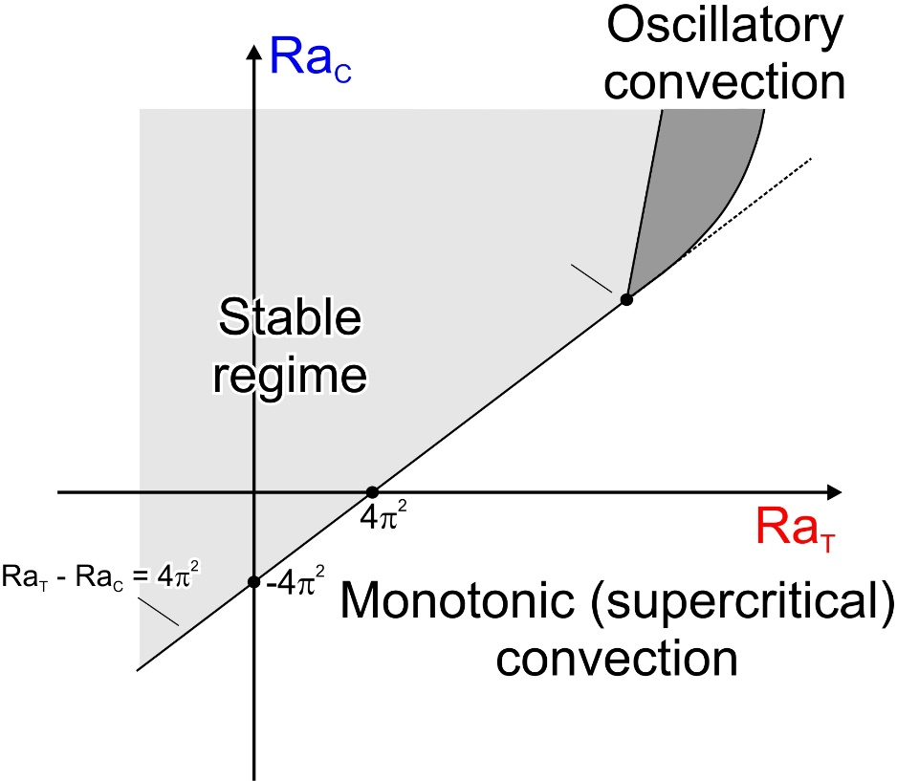
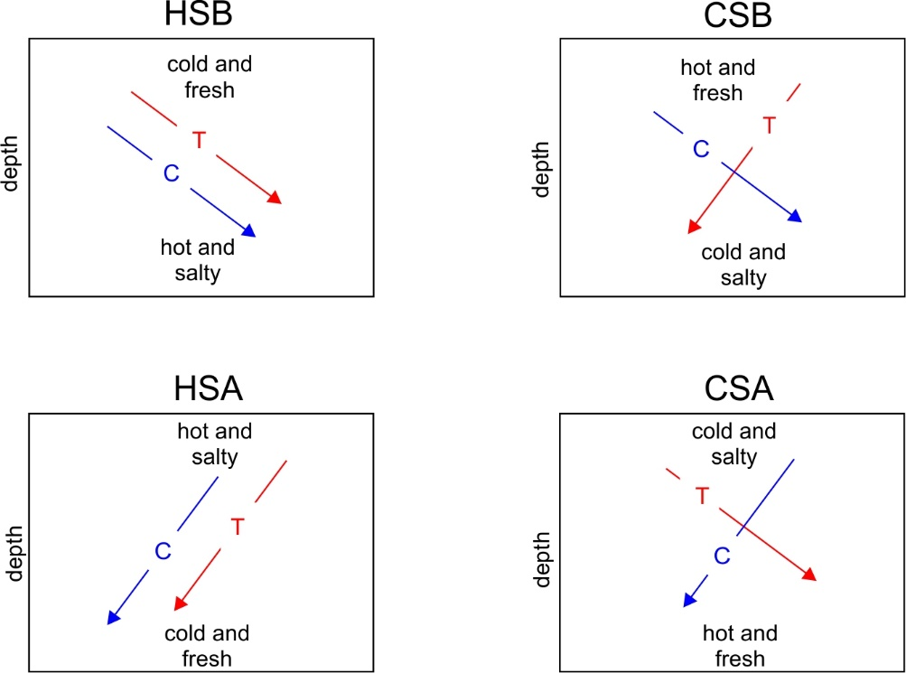
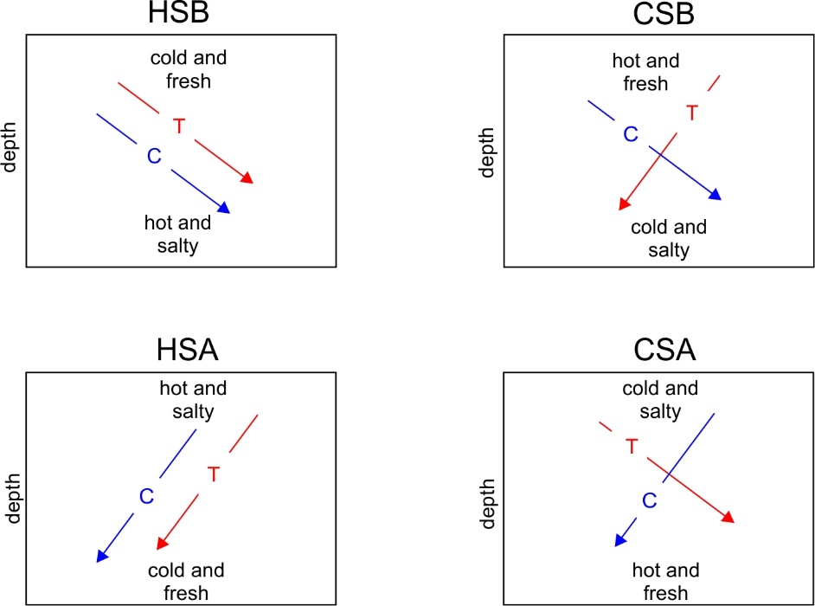
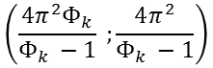
Linear (infinitesimal perturbation) stability analysis
$$\left(\frac{4π^{2}Φ_{k}}{Φ_{k} −1} ;\frac{4π^{2}}{Φ_{k} −1}\right)$$
After Diersch (2014)

Slide 8
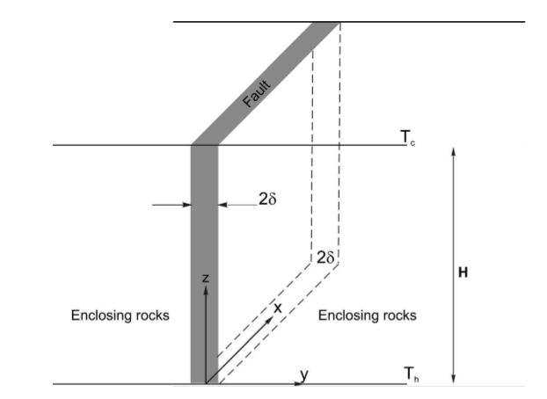
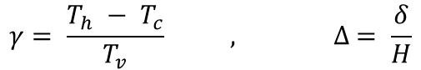
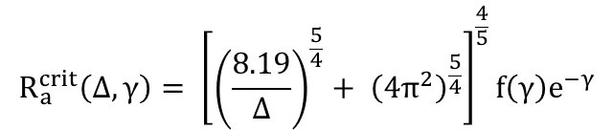
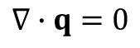
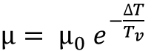
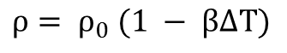
Linear (infinitesimal perturbation) stability analysis
After Malkovski and Magri (2016)
$$R_{a}^{crit}\left(∆, γ\right)= {\left[{\left(\frac{8.19}{∆}\right)}^{\frac{5}{4}}+ {\left(4π^{2}\right)}^{\frac{5}{4}}\right]}^{\frac{4}{5}}f\left(γ\right)e^{−γ}$$
$$γ= \frac{T_{h} − T_{c}}{T_{v}} , ∆ = \frac{δ}{H}$$
Assumptions:
$$∇∙q=0$$
$$ρ= ρ_{0} (1 − β∆T)$$
$μ= μ_{0} e^{−\frac{∆T}{T_{v}}}$

Slide 9



Numerical simulators used – this study
Diersch (2014)
Kolditz et al. (2012)
Commercial (license)
TH processes
FEM unstructured
External coupling
Boussinesq approx. / advective form
Opensource
THM(C) processes
FEM unstructured
External coupling
Boussinesq approx. / advective form
- GOLEM
Gaston et al. (2009) - Jacquey and Cacace (poster S1), Jacquey et al. (oral S3), Cacace et al (poster S6)
Opensource
THM processes
FEM unstructured
Monolithic coupling
Non-Boussinesq / Flux divergence/advective form

Slide 10
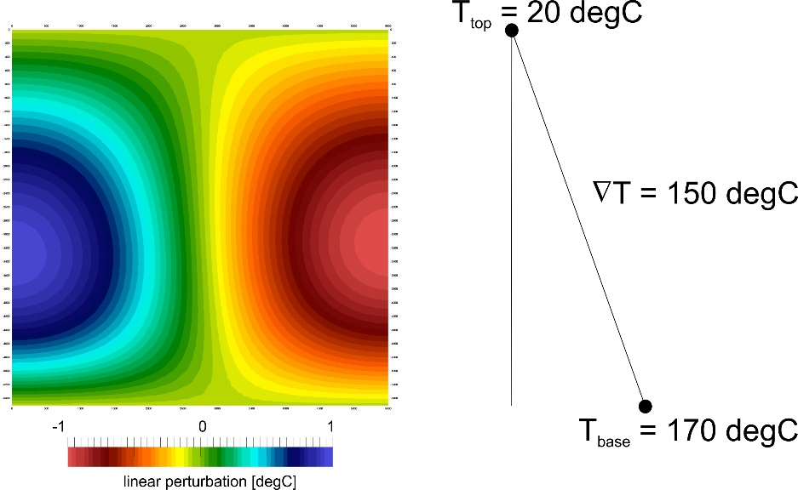
2D problem formulation
Initial and boundary setting Material properties
Δ [−] | n [-] | β [K^-1] | cp [J/m^3/K] | λ [W/M/K] | κ [m^2]
3.63e-3 | 1e-3 | 4.3e-4 | 4200 | 3 | 1.7e-3
$$ε\left(x,z,t\right)=sin\left(πz\right)\cos\left(πx\right)÷±1 degC$$
$$R_{a}^{crit}\left(∆ =3.63 {10}^{−3}, γ=2.42\right) \sim 753$$
After Malkovski and Magri (2016)

Slide 11
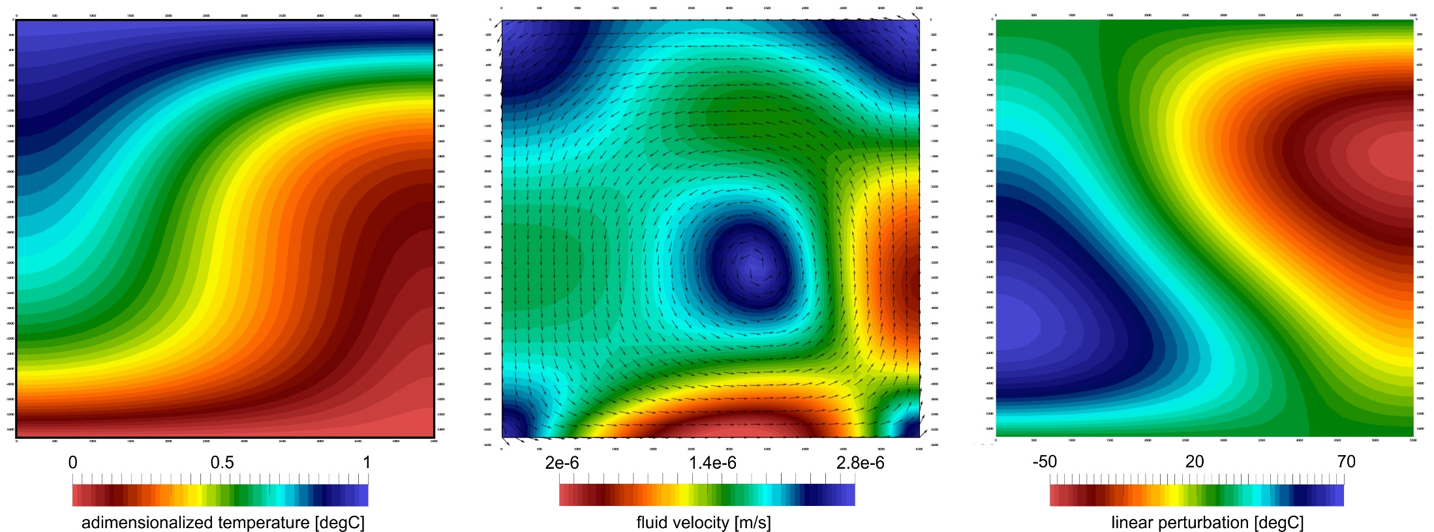
Numerical results (Golem-moose) @ 30 years – Ra = 830

Slide 12
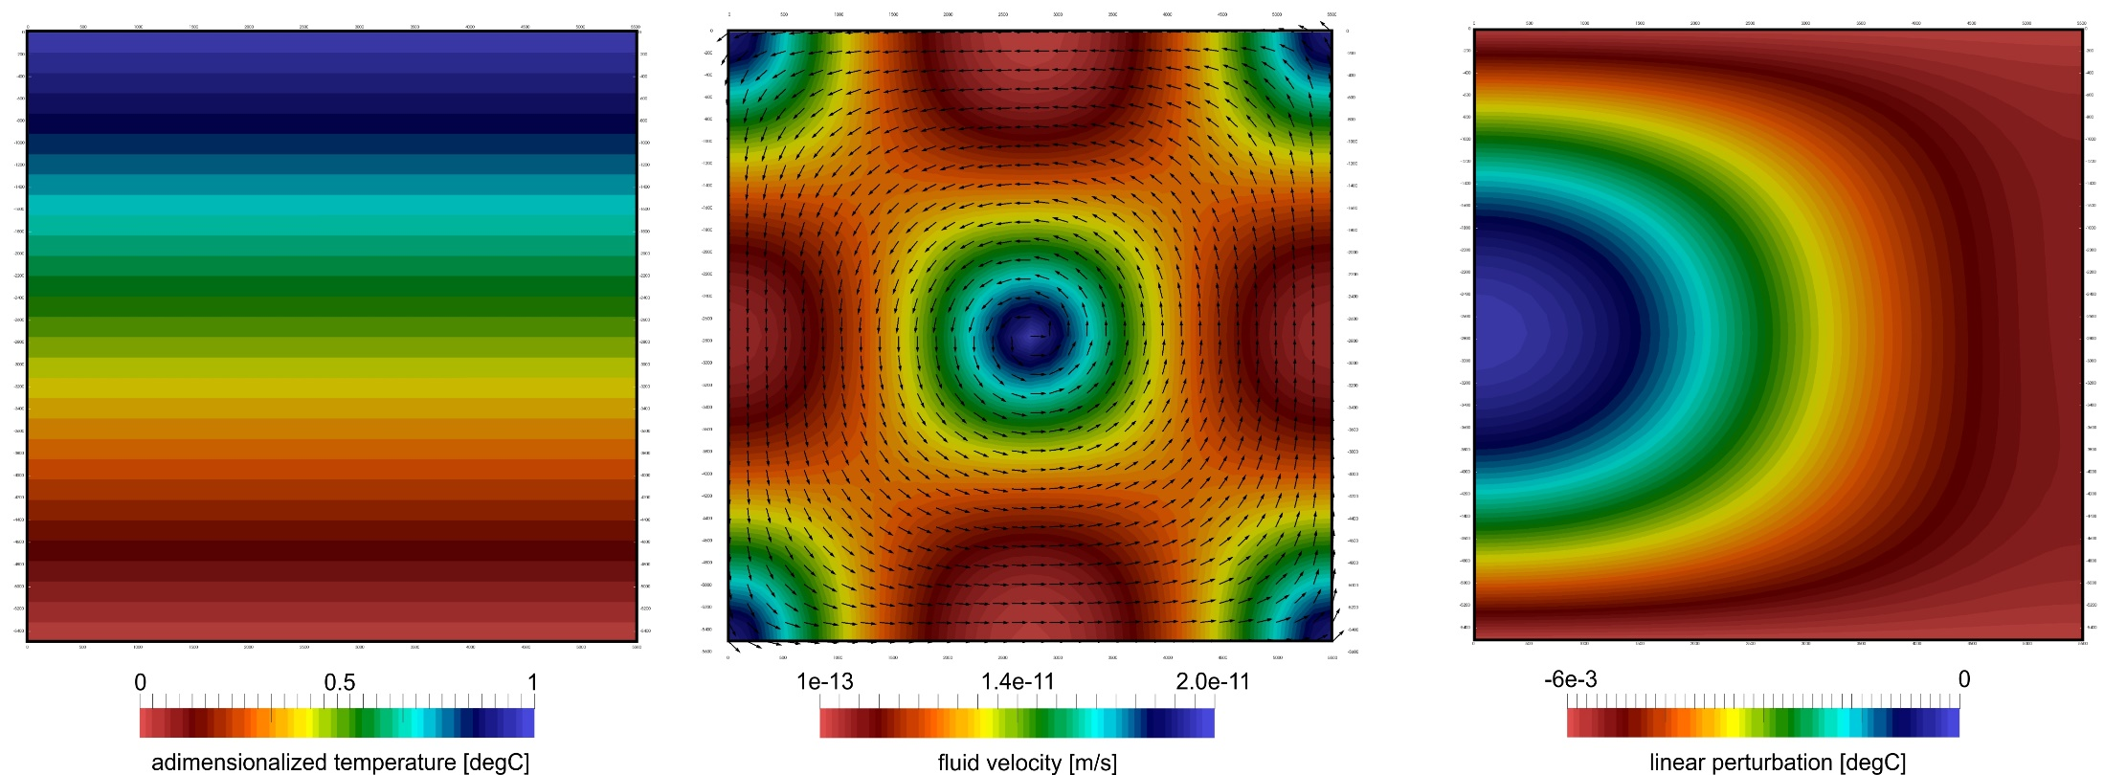
Numerical results (Golem-moose) @ 30 years – isoviscous

Slide 13
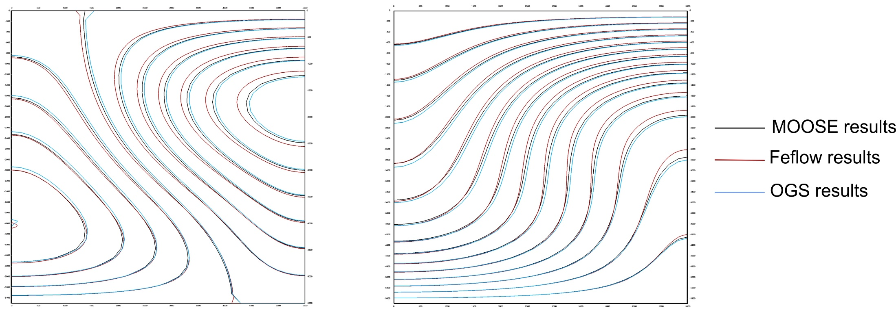
Numerical results comparison @ approx. 30 years

Slide 14
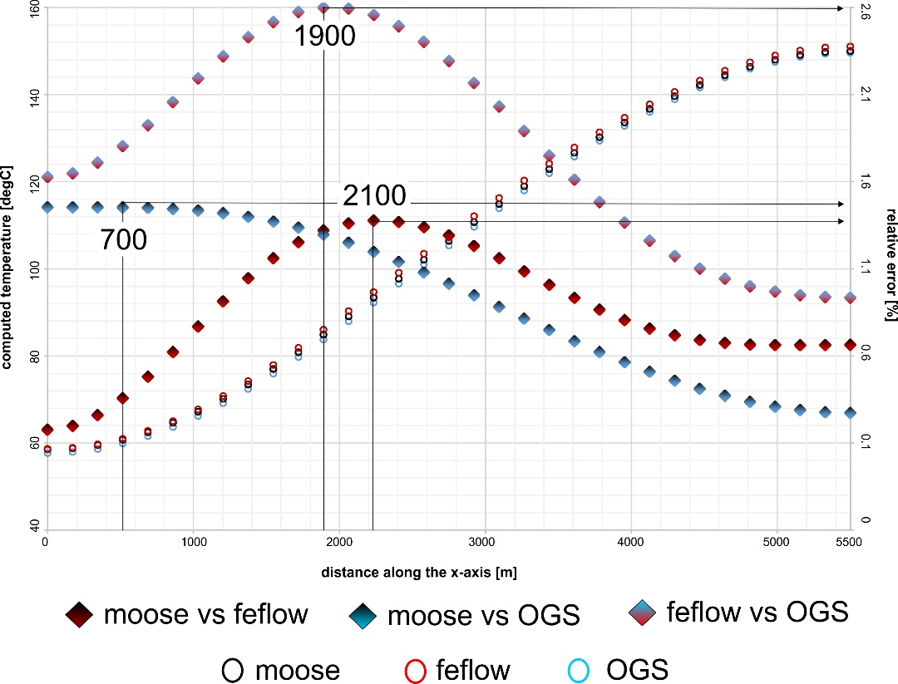
Numerical results comparison @ approx. 30 years (middle plane)

Slide 15
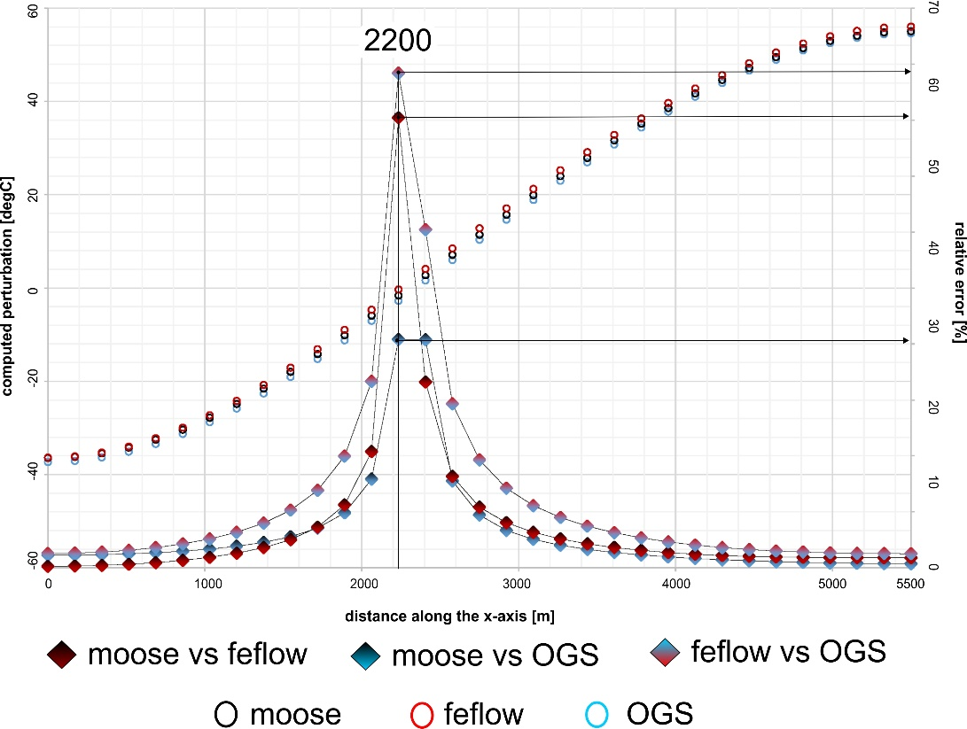
Numerical results comparison @ approx. 30 years (middle plane)

Slide 16
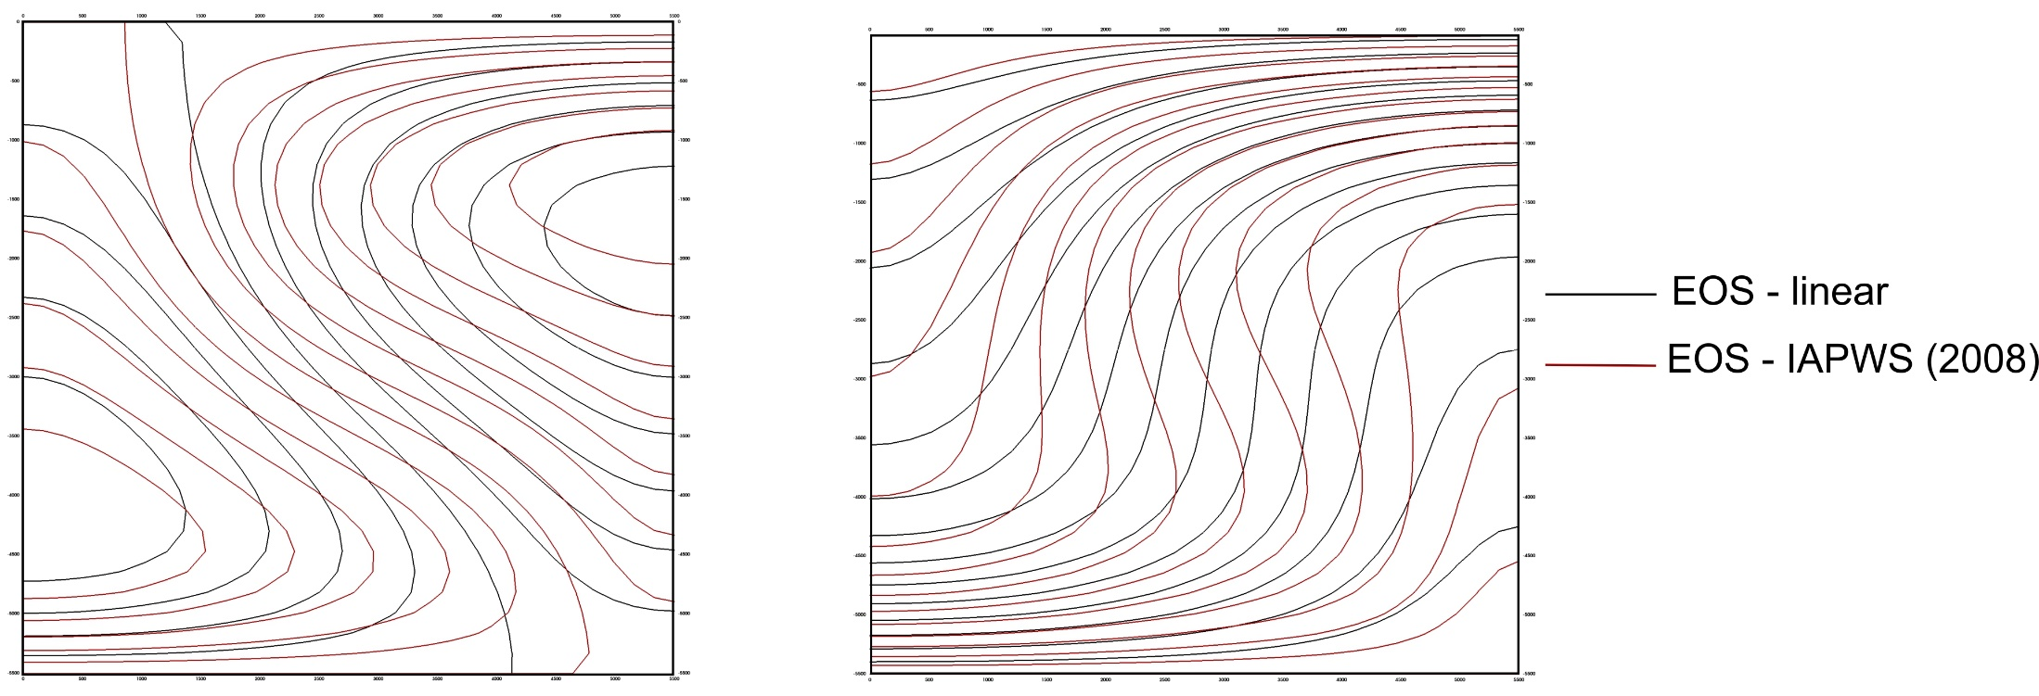
Numerical results comparison of EOS

Slide 17
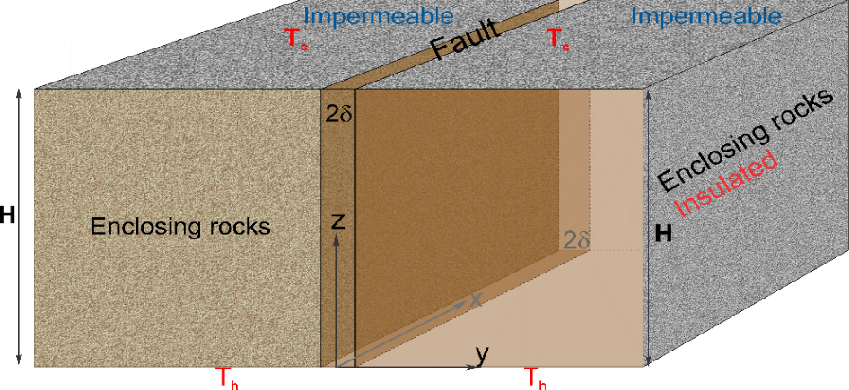
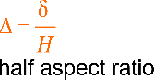
3D problem formulation
Initial and boundary setting Material properties
$$ε\left(x, y,z,t\right)=sin\left(πz\right)\cos\left(πy\right)÷±1 degC$$
$R_{a}^{crit}\left(∆ =3.63 {10}^{−3}, γ=2.42\right) \sim 1350$

Slide 18
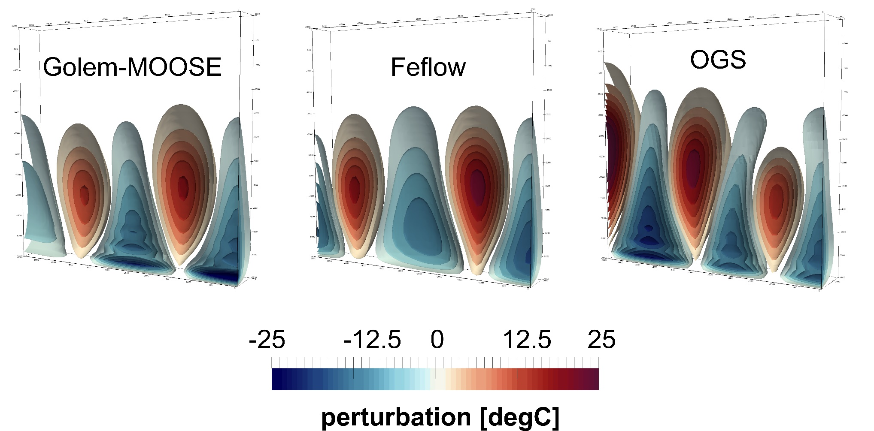
Numerical results @ approx. 80 kyears
5 convective cells
4 convective cells
4 convective cells

Slide 19
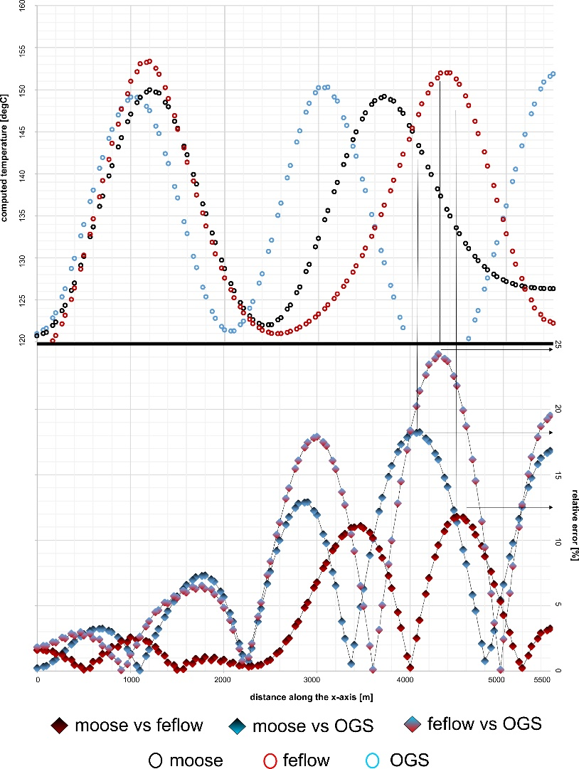
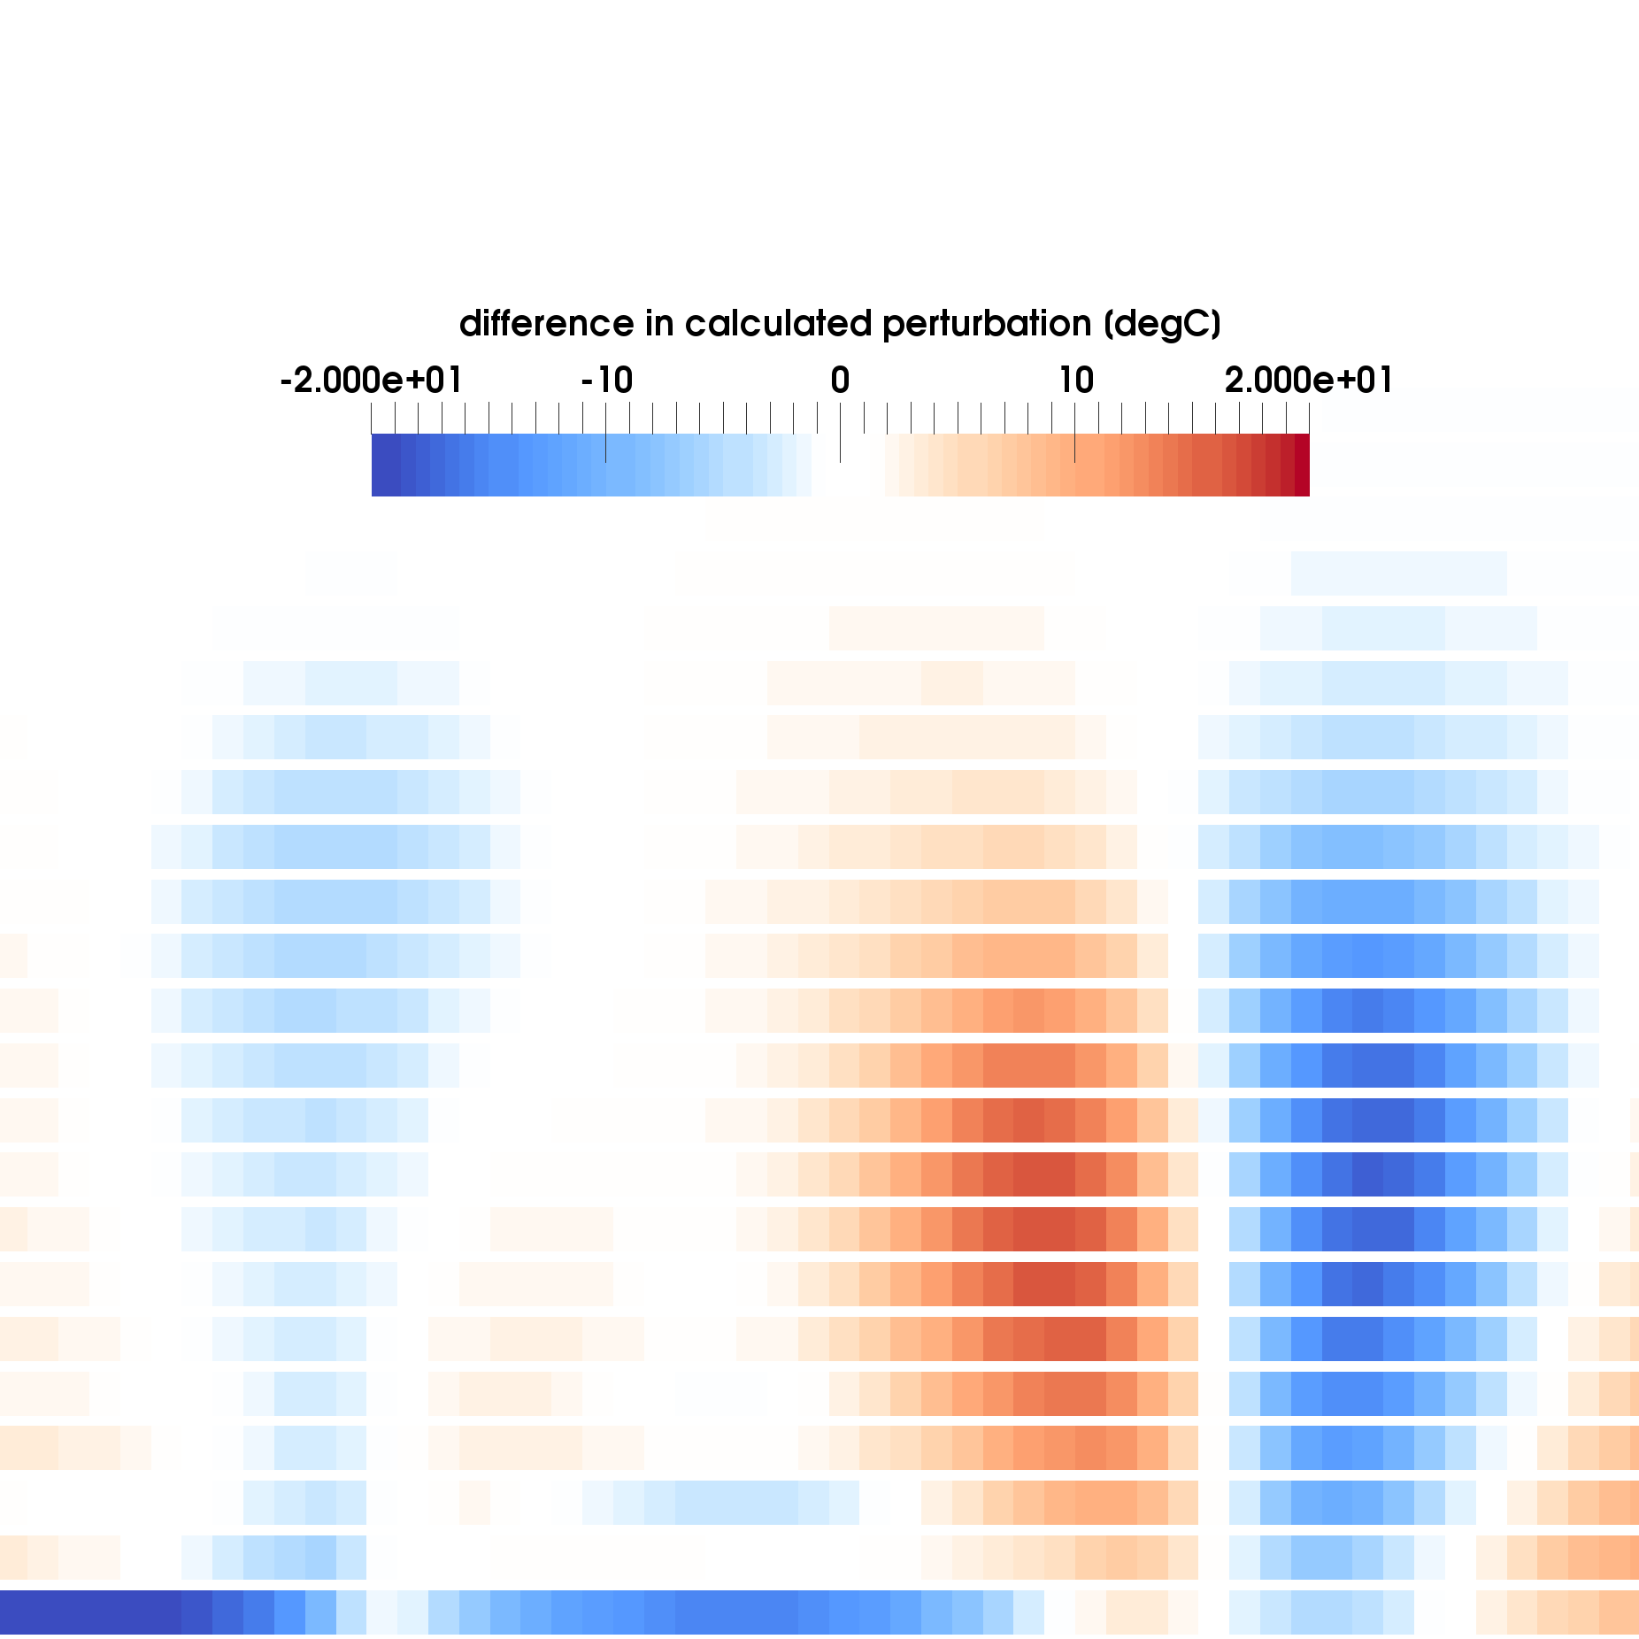
Numerical results comparison @ approx. 80 kyears (plane 4.2 km)
Moose vs Feflow

Slide 20
Numerical results comparison @ approx. 80 kyears (plane 4.2 km)
λ~3200 m
λ~2600 m
Moose vs Feflow
λ~2000 m

Slide 21
Summary and (tentative) conclusions
Combination of linear perturbation analysis (Malkowsky & Magri, 2016) and numerical simulations
Correctly predicts onset of fault convection
In 2D: excellent temperature fit of all numerical models
In 3D: temperature patterns and ranges are qualitative similar, however differences exist:
Mesh convergence?
Numerical error propagation?
Time stepping? ... To be investigated
The presented study further stresses that:
3D large-scale DD flow is an extremely non-linear and self-perturbing problem
Results of case-studies must be interpreted carefully and require additional constraints (field data)
The benchmark shows OGS and MOOSE-GOLEM capabilities to strongly coupled and non-linear systems

